Slide 1
Senior Thesis 2013
Ji Won Park
Mechanical Option
Advisor: Dr. Stephen Treado
Northfield Mental Healthcare Center
Northfield, Ohio

Slide 2
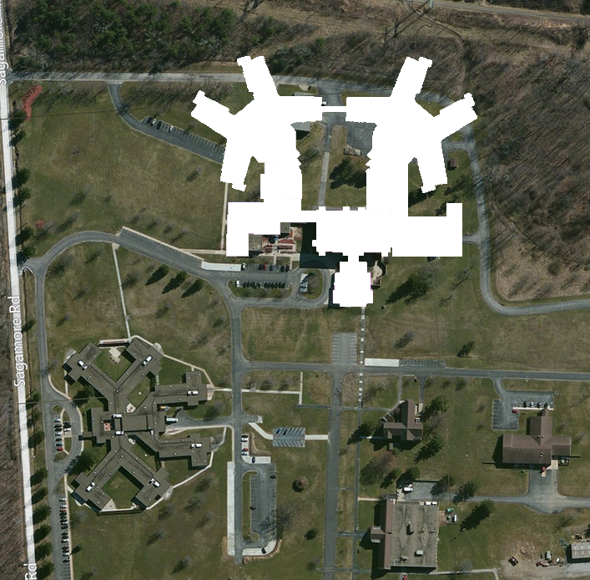
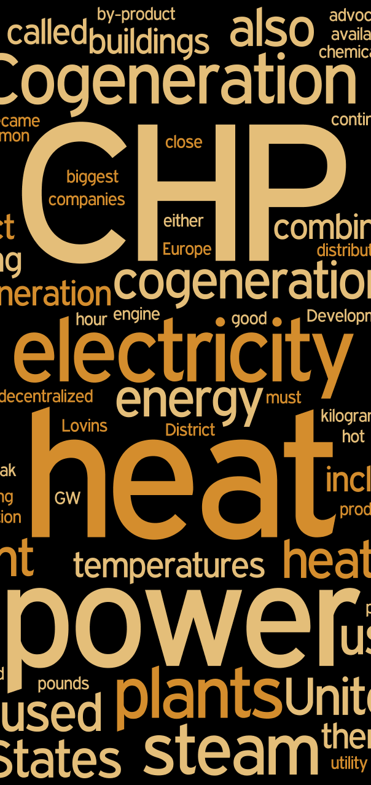
Northfield Mental Healthcare Center
Building Information
Site Map
• Introduction
• Northfield Mental Healthcare
• Mechanical System
• Design Goals
• Alternative 1: Cogeneration
• Alternative 2: Tri-generation
• Comparison
• Breadth: Electrical Breadth
• Summary
• Acknowledgements
• Questions
Function: mental clinic
SIZE: ~260,000 SF
(Additional 200,000 SF to existing 60,000 SF)
Overall Cost: ~62.5 million
Delivery Method: design-bid-build (multiple prime)
Construction Date: approx. April, 2013 – January, 2014

Slide 3
Northfield Mental Healthcare Center
Project Team
Project Overview
• Introduction
• Northfield Mental Healthcare
• Mechanical System
• Design Goals
• Alternative 1: Cogeneration
• Alternative 2: Tri-generation
• Comparison
• Breadth: Electrical Breadth
• Summary
• Acknowledgements
• Questions
Provided high quality for care and safety
Designed to respect surrounding facilities
Provided additional recreation areas and therapeutic spaces
Used face brick exterior walls to match the existing building
Used smooth CMU, texted CMU, and curtain walls to highlight the new design
Owner: Ohio Department of Mental Health
Architects: Hasenstab Architects, Inc.
Landscape: Bedell-Tucci, LLC (N/A)
MEP and Fire Protection: Scheeser Buckley Mayfield, LLC
Structural Engineers: Thorson Baker & Associates

Slide 4
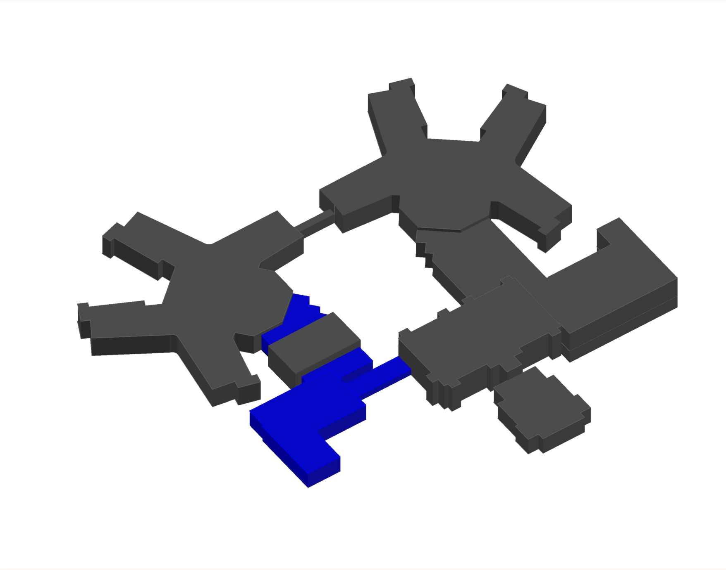
Northfield Mental Healthcare Center
Existing Mechanical System
Air Side
• Introduction
• Northfield Mental Healthcare
• Mechanical System
• Design Goals
• Alternative 1: Cogeneration
• Alternative 2: Tri-generation
• Comparison
• Breadth: Electrical Breadth
• Summary
• Acknowledgements
• Questions
Existing:
Existing Constant Volume AHU (70,000 CFM)
Existing Constant Volume AHU (14,000 CFM)
Patient Wing Left / Right:
2 Custom AHUs (65,000 CFM Each) w/ DDC-VAV terminals
Clinc / Admin:
Variable Air Volume AHU (7,950 CFM) w/ DDC-VAV terminals
Dietary:
Variable Air Volume AHU (8,400 CFM) w/ DDC-VAV terminals
Gym:
Constant Volume AHU (3,700 CFM) w/ Sensible Wheel
Boiler Plant & Chiller Plant & Electrical Room
2 Constant Volume AHUs (5,000 CFM Each)
Variable Air Volume AHU (6,000 CFM)

Slide 5
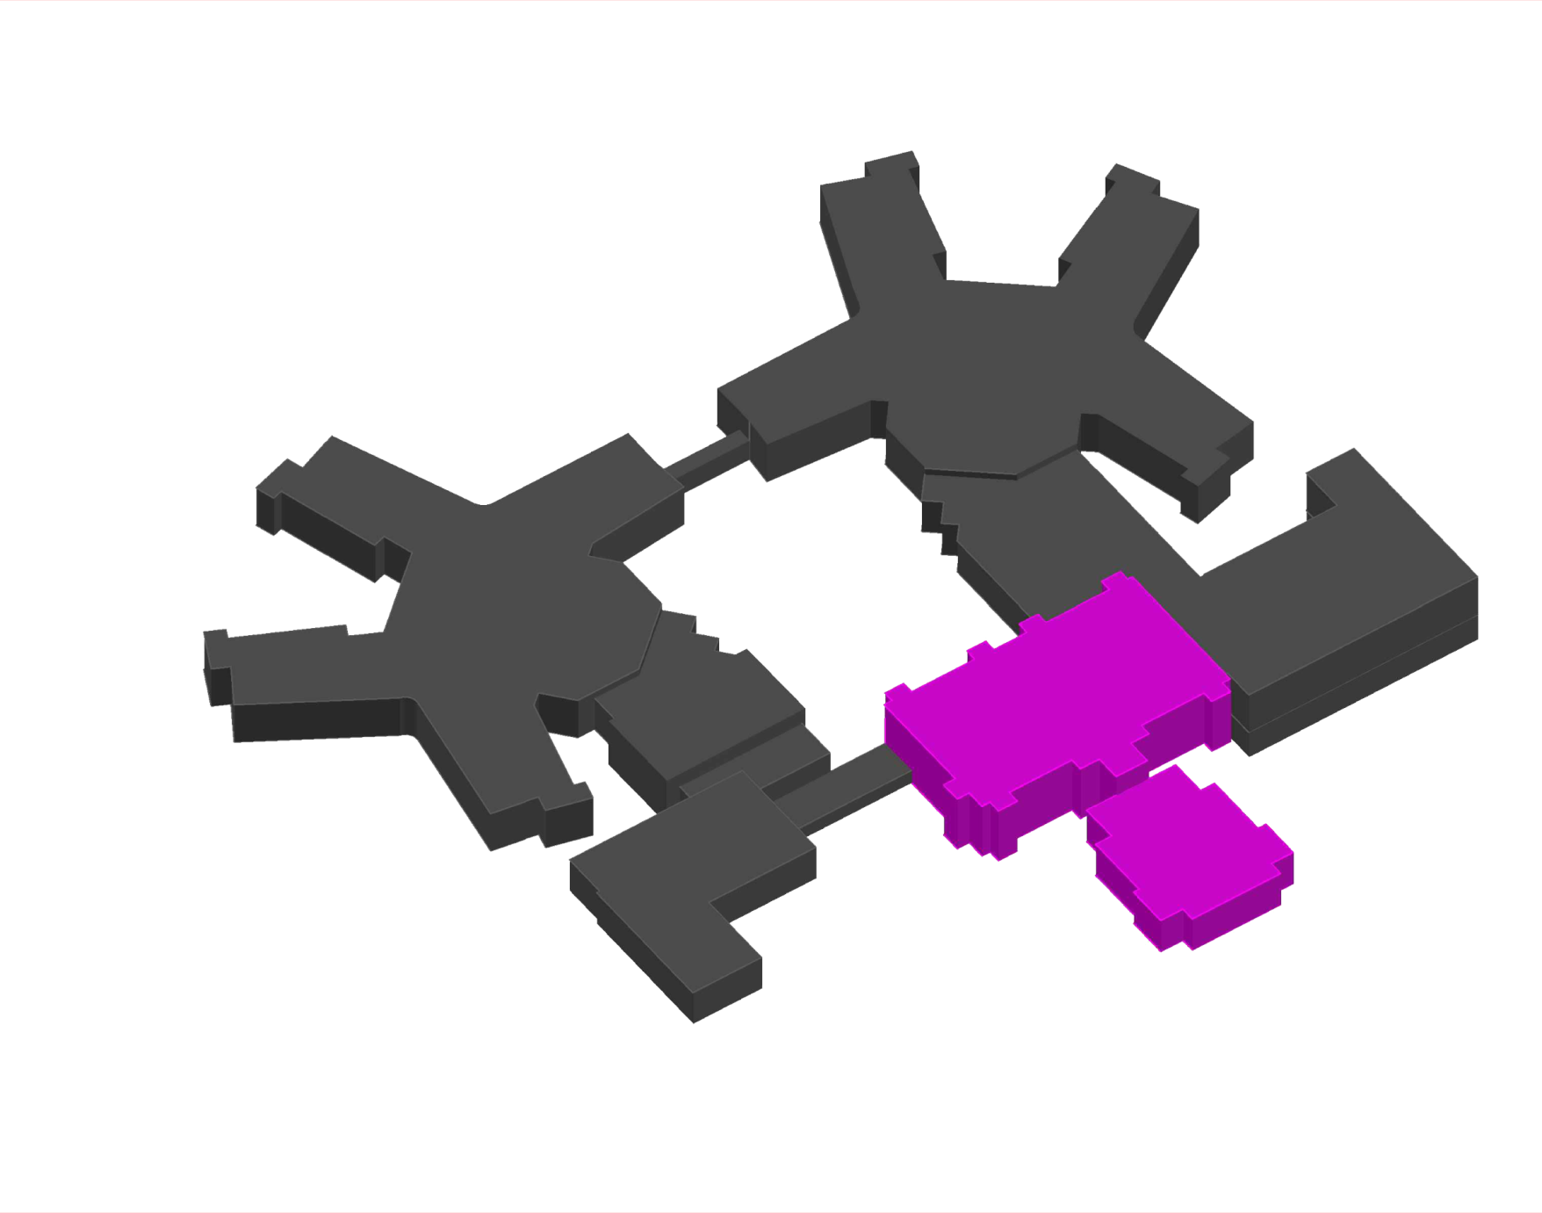
Northfield Mental Healthcare Center
Existing Mechanical System
Air Side
• Introduction
• Northfield Mental Healthcare
• Mechanical System
• Design Goals
• Alternative 1: Cogeneration
• Alternative 2: Tri-generation
• Comparison
• Breadth: Electrical Breadth
• Summary
• Acknowledgements
• Questions
Existing:
Existing Constant Volume AHU (70,000 CFM)
Existing Constant Volume AHU (14,000 CFM)
Patient Wing Left / Right:
2 Custom AHUs (65,000 CFM Each) w/ DDC-VAV terminals
Clinc / Admin:
Variable Air Volume AHU (7,950 CFM) w/ DDC-VAV terminals
Dietary:
Variable Air Volume AHU (8,400 CFM) w/ DDC-VAV terminals
Gym:
Constant Volume AHU (3,700 CFM) w/ Sensible Wheel
Boiler Plant & Chiller Plant & Electrical Room
2 Constant Volume AHUs (5,000 CFM Each)
Variable Air Volume AHU (6,000 CFM)

Slide 6
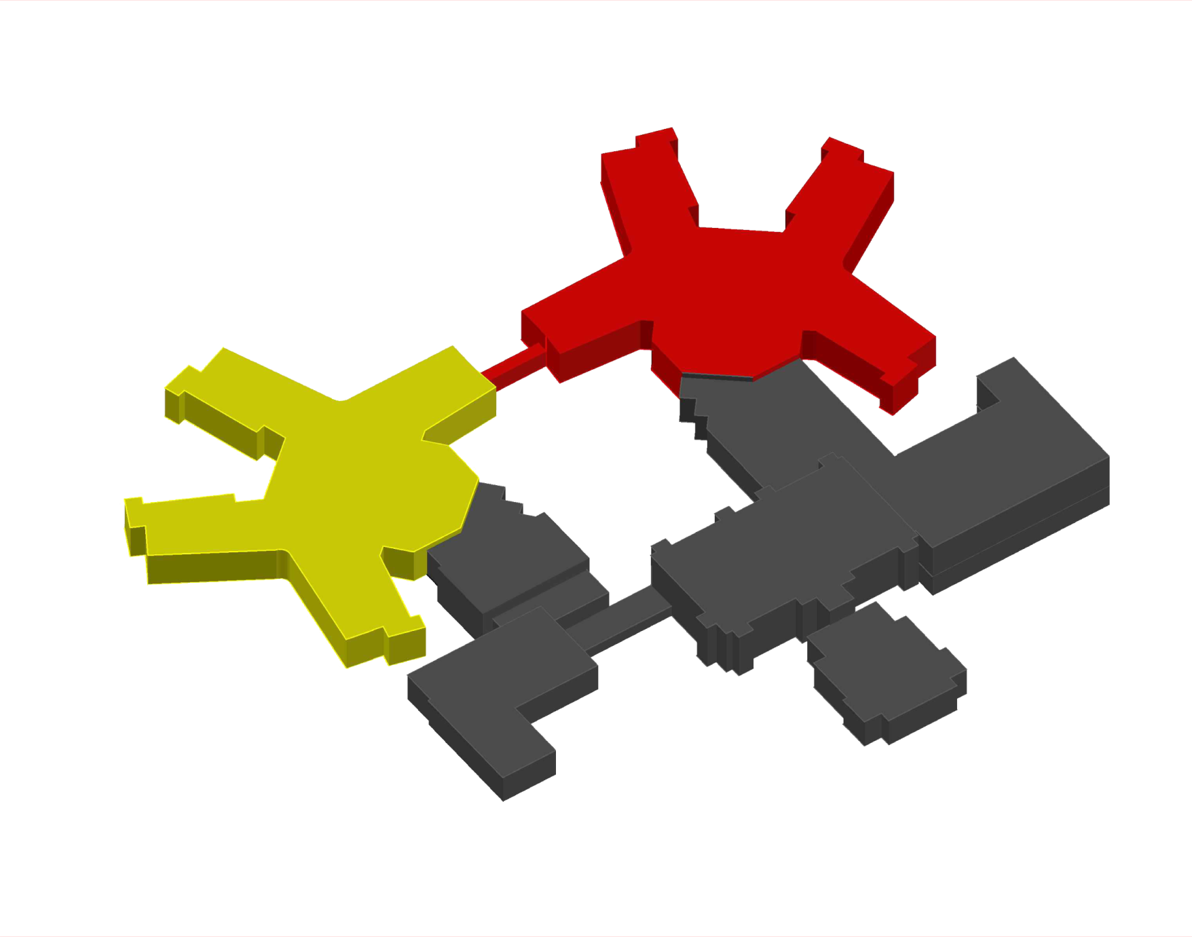
Northfield Mental Healthcare Center
Existing Mechanical System
Air Side
• Introduction
• Northfield Mental Healthcare
• Mechanical System
• Design Goals
• Alternative 1: Cogeneration
• Alternative 2: Tri-generation
• Comparison
• Breadth: Electrical Breadth
• Summary
• Acknowledgements
• Questions
Existing:
Existing Constant Volume AHU (70,000 CFM)
Existing Constant Volume AHU (14,000 CFM)
Patient Wing Left / Right:
2 Custom AHUs (65,000 CFM Each) w/ DDC-VAV terminals
Clinc / Admin:
Variable Air Volume AHU (7,950 CFM) w/ DDC-VAV terminals
Dietary:
Variable Air Volume AHU (8,400 CFM) w/ DDC-VAV terminals
Gym:
Constant Volume AHU (3,700 CFM) w/ Sensible Wheel
Boiler Plant & Chiller Plant & Electrical Room
2 Constant Volume AHUs (5,000 CFM Each)
Variable Air Volume AHU (6,000 CFM)

Slide 7
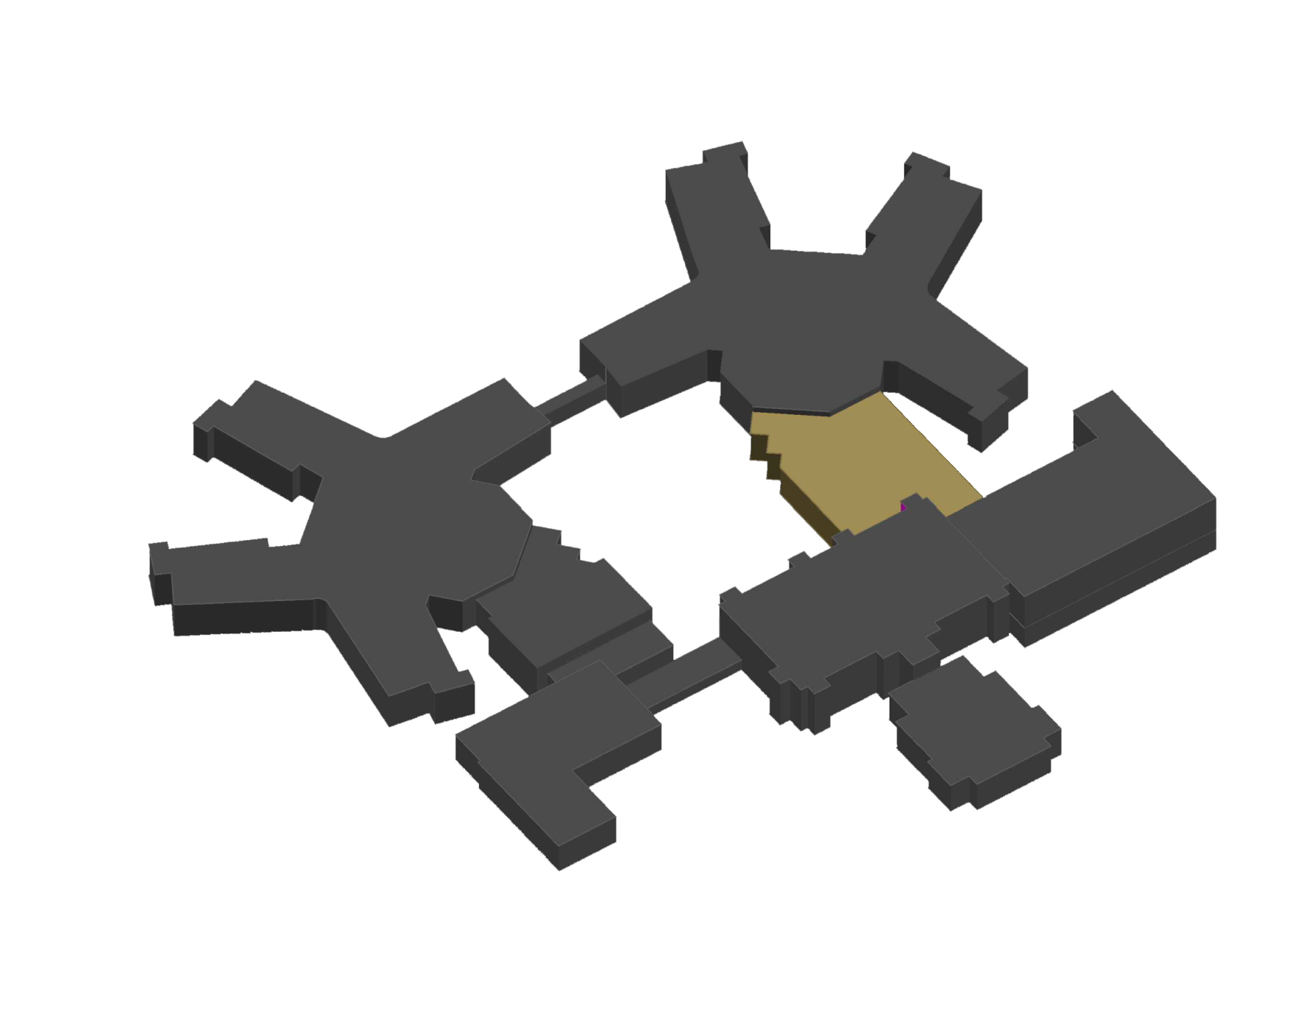
Northfield Mental Healthcare Center
Existing Mechanical System
Air Side
• Introduction
• Northfield Mental Healthcare
• Mechanical System
• Design Goals
• Alternative 1: Cogeneration
• Alternative 2: Tri-generation
• Comparison
• Breadth: Electrical Breadth
• Summary
• Acknowledgements
• Questions
Existing:
Existing Constant Volume AHU (70,000 CFM)
Existing Constant Volume AHU (14,000 CFM)
Patient Wing Left / Right:
2 Custom AHUs (65,000 CFM Each) w/ DDC-VAV terminals
Clinc / Admin:
Variable Air Volume AHU (7,950 CFM) w/ DDC-VAV terminals
Dietary:
Variable Air Volume AHU (8,400 CFM) w/ DDC-VAV terminals
Gym:
Constant Volume AHU (3,700 CFM) w/ Sensible Wheel
Boiler Plant & Chiller Plant & Electrical Room
2 Constant Volume AHUs (5,000 CFM Each)
Variable Air Volume AHU (6,000 CFM)

Slide 8
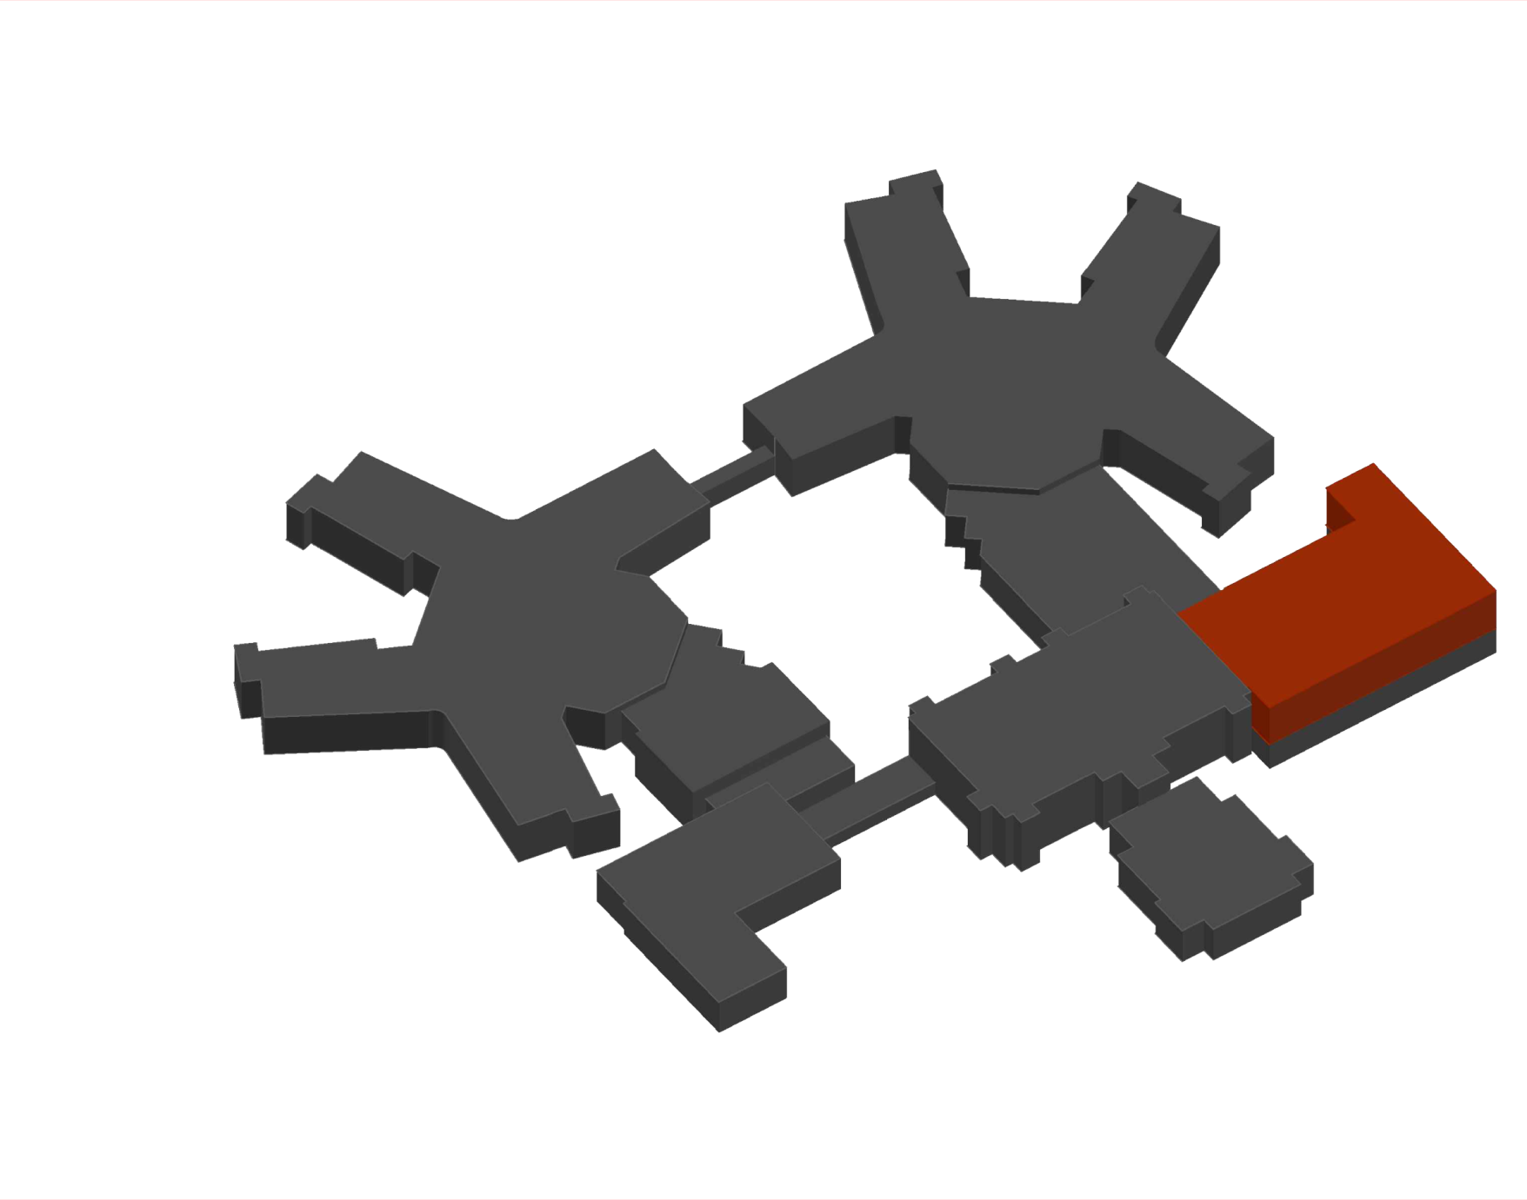
Northfield Mental Healthcare Center
Existing Mechanical System
Air Side
• Introduction
• Northfield Mental Healthcare
• Mechanical System
• Design Goals
• Alternative 1: Cogeneration
• Alternative 2: Tri-generation
• Comparison
• Breadth: Electrical Breadth
• Summary
• Acknowledgements
• Questions
Existing:
Existing Constant Volume AHU (70,000 CFM)
Existing Constant Volume AHU (14,000 CFM)
Patient Wing Left / Right:
2 Custom AHUs (65,000 CFM Each) w/ DDC-VAV terminals
Clinc / Admin:
Variable Air Volume AHU (7,950 CFM) w/ DDC-VAV terminals
Dietary:
Variable Air Volume AHU (8,400 CFM) w/ DDC-VAV terminals
Gym:
Constant Volume AHU (3,700 CFM) w/ Sensible Wheel
Boiler Plant & Chiller Plant & Electrical Room
2 Constant Volume AHUs (5,000 CFM Each)
Variable Air Volume AHU (6,000 CFM)

Slide 9
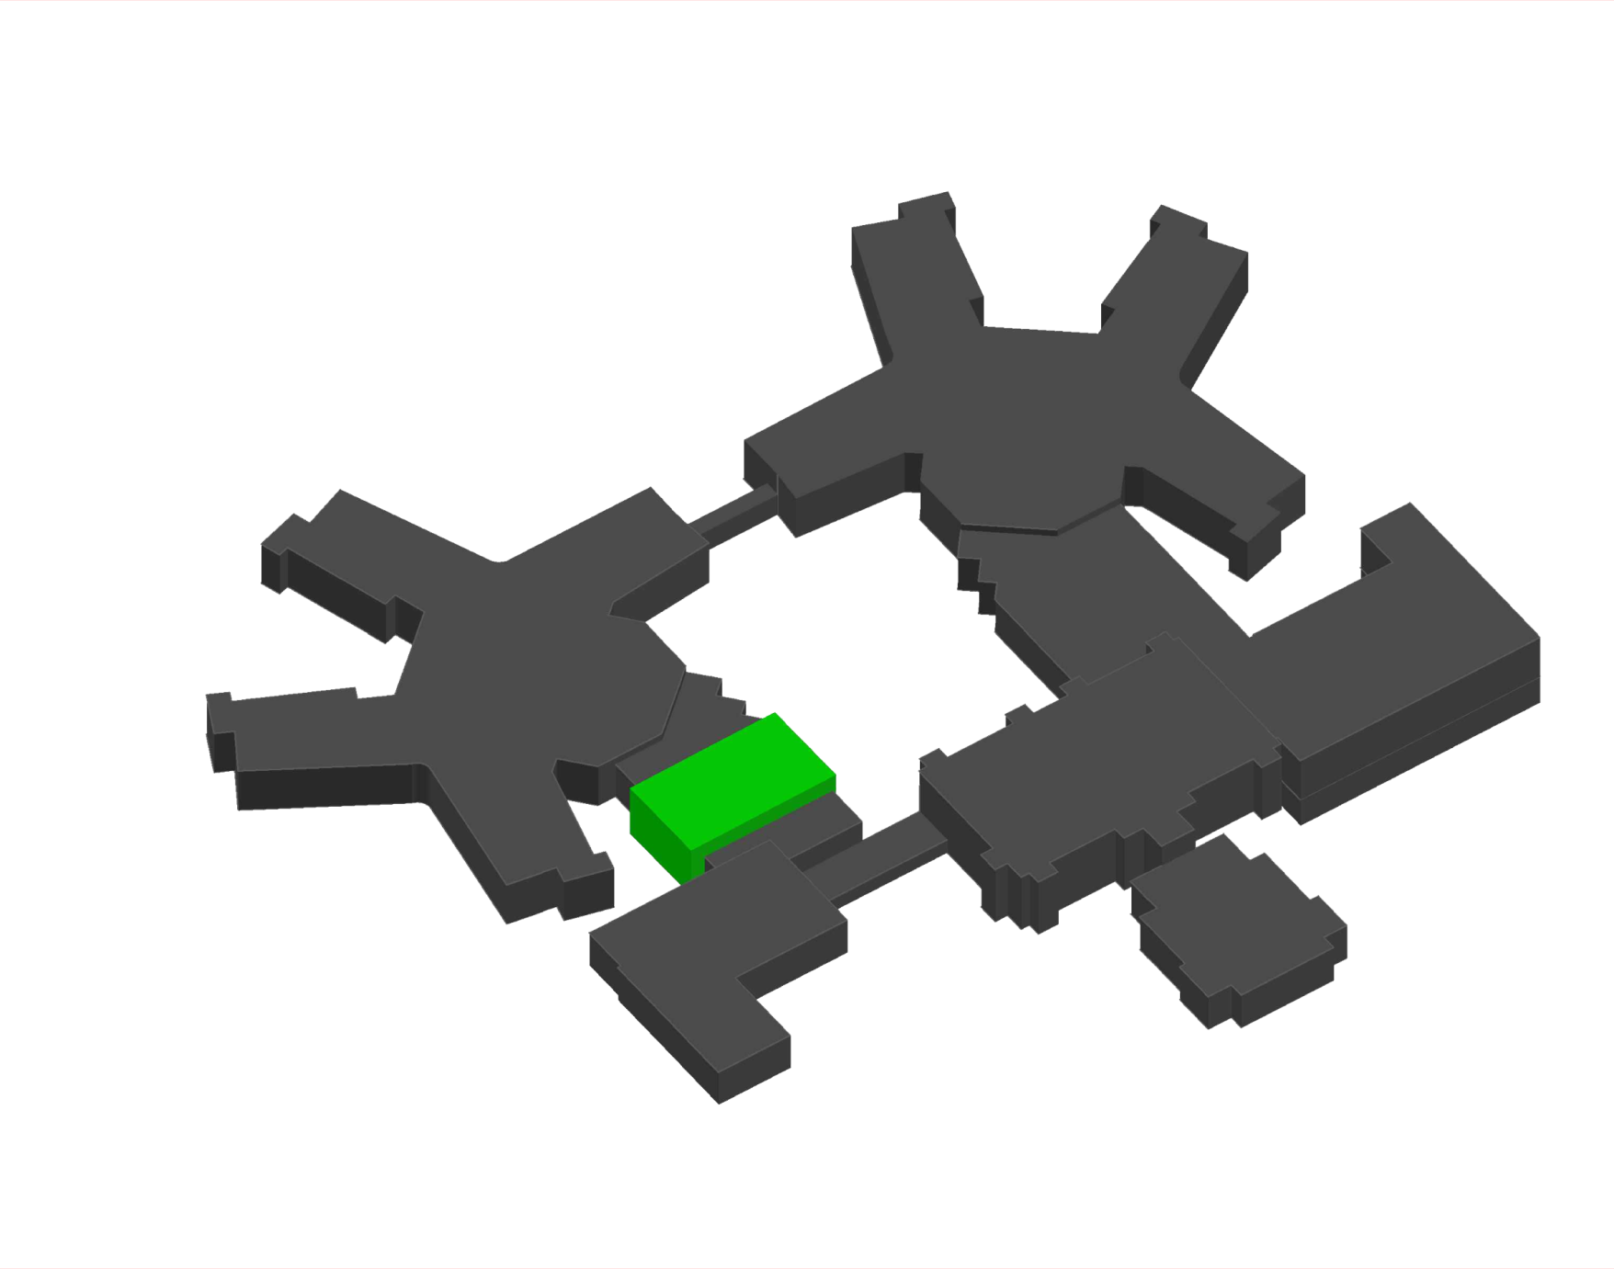
Northfield Mental Healthcare Center
Existing Mechanical System
Air Side
• Introduction
• Northfield Mental Healthcare
• Mechanical System
• Design Goals
• Alternative 1: Cogeneration
• Alternative 2: Tri-generation
• Comparison
• Breadth: Electrical Breadth
• Summary
• Acknowledgements
• Questions
Existing:
Existing Constant Volume AHU (70,000 CFM)
Existing Constant Volume AHU (14,000 CFM)
Patient Wing Left / Right:
2 Custom AHUs (65,000 CFM Each) w/ DDC-VAV terminals
Clinc / Admin:
Variable Air Volume AHU (7,950 CFM) w/ DDC-VAV terminals
Dietary:
Variable Air Volume AHU (8,400 CFM) w/ DDC-VAV terminals
Gym:
Constant Volume AHU (3,700 CFM) w/ Sensible Wheel
Boiler Plant & Chiller Plant & Electrical Room
2 Constant Volume AHUs (5,000 CFM Each)
Variable Air Volume AHU (6,000 CFM)

Slide 10
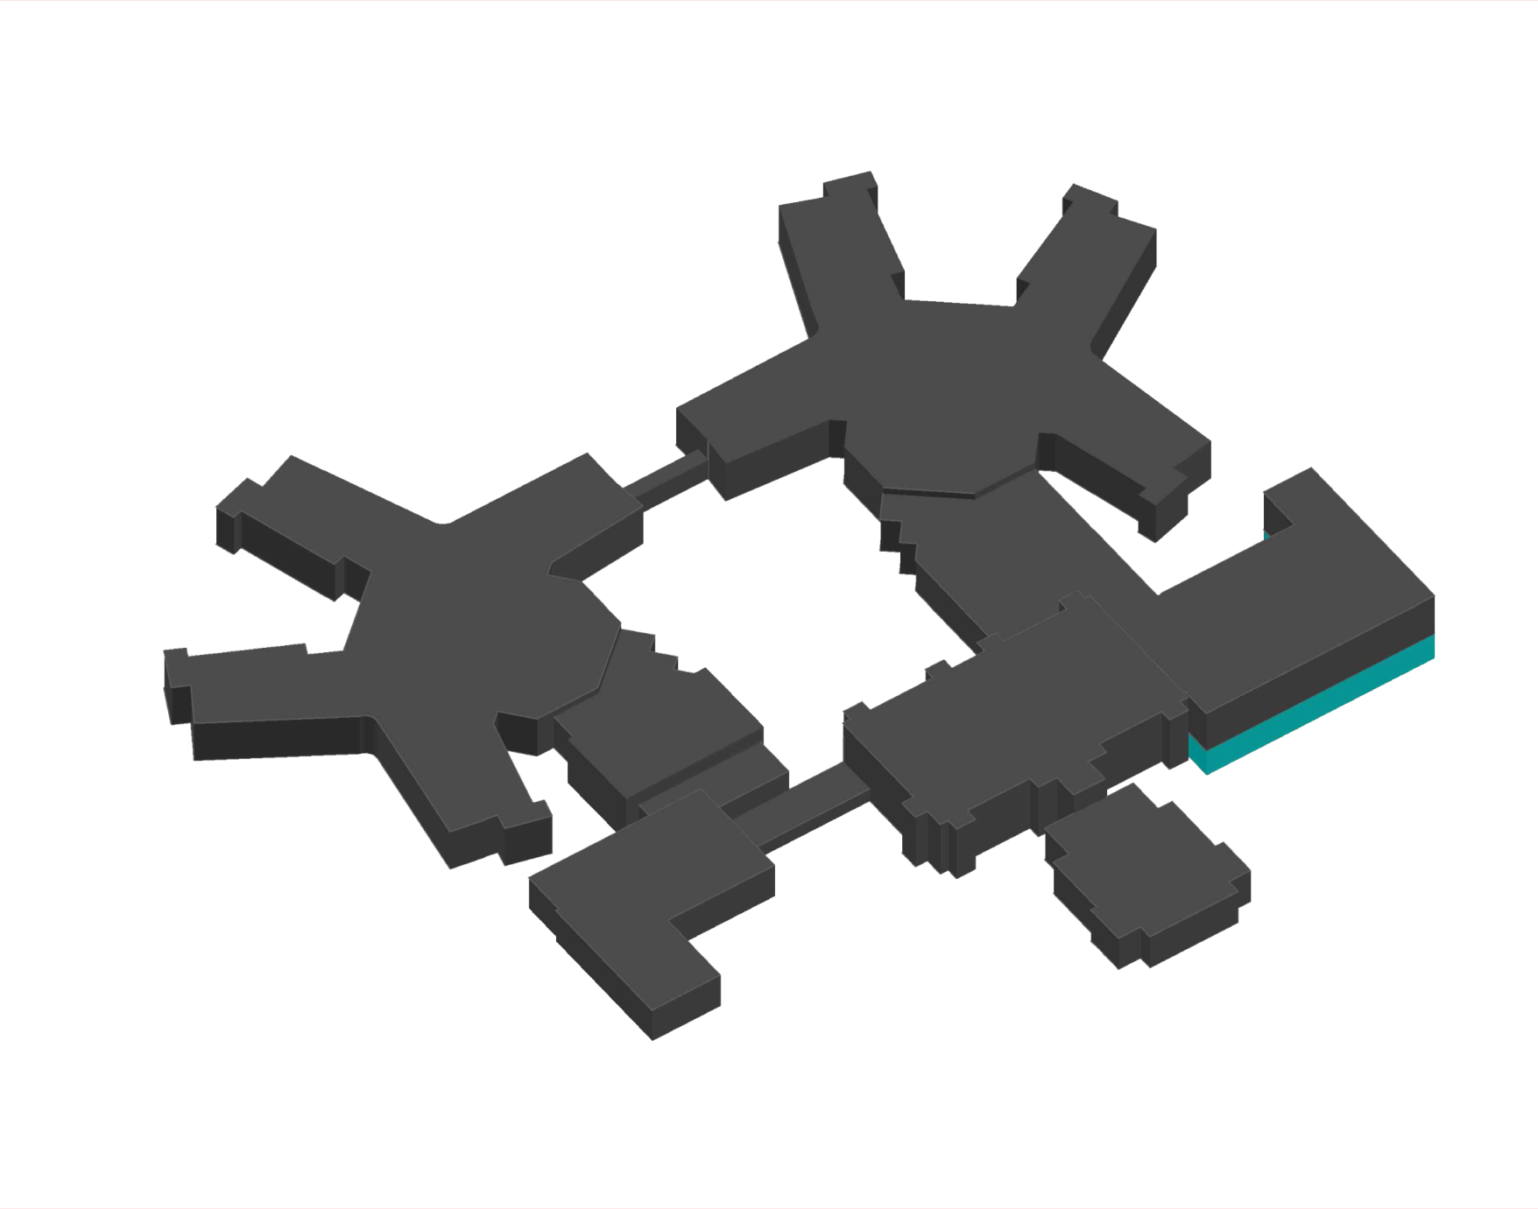
Northfield Mental Healthcare Center
Existing Mechanical System
Air Side
• Introduction
• Northfield Mental Healthcare
• Mechanical System
• Design Goals
• Alternative 1: Cogeneration
• Alternative 2: Tri-generation
• Comparison
• Breadth: Electrical Breadth
• Summary
• Acknowledgements
• Questions
Existing:
Existing Constant Volume AHU (70,000 CFM)
Existing Constant Volume AHU (14,000 CFM)
Patient Wing Left / Right:
2 Custom AHUs (65,000 CFM Each) w/ DDC-VAV terminals
Clinc / Admin:
Variable Air Volume AHU (7,950 CFM) w/ DDC-VAV terminals
Dietary:
Variable Air Volume AHU (8,400 CFM) w/ DDC-VAV terminals
Gym:
Constant Volume AHU (3,700 CFM) w/ Sensible Wheel
Boiler Plant & Chiller Plant & Electrical Room
2 Constant Volume AHUs (5,000 CFM Each)
Variable Air Volume AHU (6,000 CFM)

Slide 11
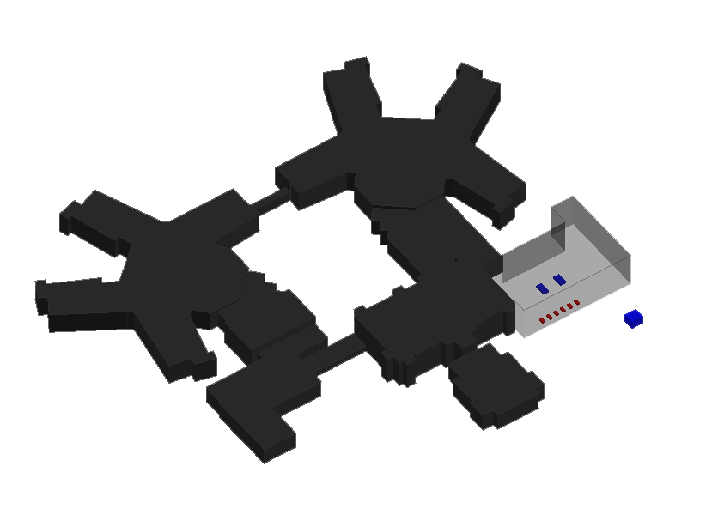
Northfield Mental Healthcare Center
Existing Mechanical System
Water Side
• Introduction
• Northfield Mental Healthcare
• Mechanical System
• Design Goals
• Alternative 1: Cogeneration
• Alternative 2: Tri-generation
• Comparison
• Breadth: Electrical Breadth
• Summary
• Acknowledgements
• Questions
6 Natural Gas Fired Boilers (4,000 MBH each)
2 Electric Centrifugal Chillers (450 Tons each)
A 2-cell-cooling tower (Max. 900 Tons)

Slide 12
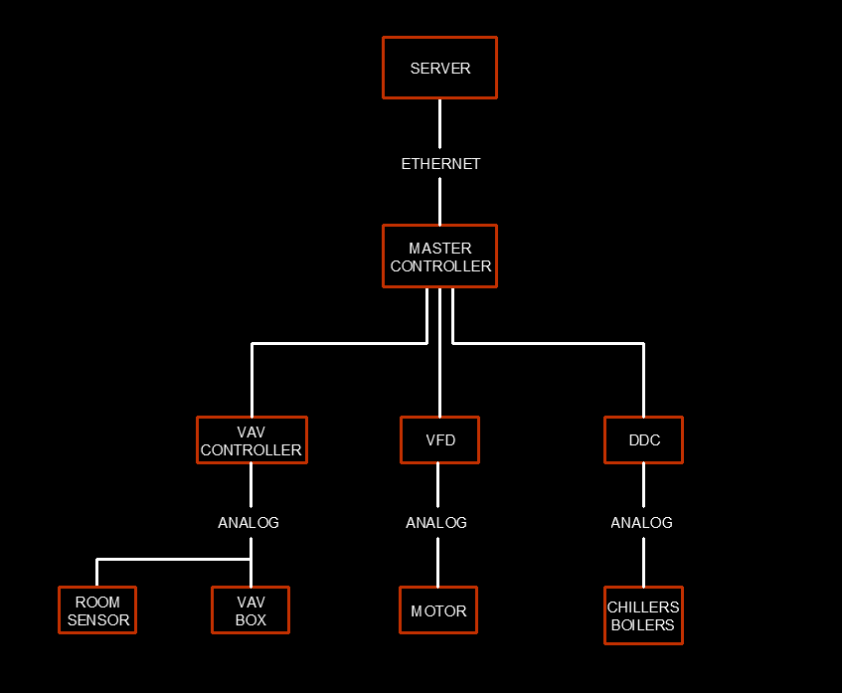
Northfield Mental Healthcare Center
Existing Mechanical System
Control System
• Introduction
• Northfield Mental Healthcare
• Mechanical System
• Design Goals
• Alternative 1: Cogeneration
• Alternative 2: Tri-generation
• Comparison
• Breadth: Electrical Breadth
• Summary
• Acknowledgements
• Questions
Energy Efficient Devices
DDC-VAV terminals for AHU 1, 2, 4 & 5
VFD for supply and return fans for AHU 1, 2, 3, 4, 5 & 8
VFD for Secondary Heating Water Pumps
VFD for Secondary Chilled Water Pumps
VFD for Cooling Tower
VFD for Cooling Tower Pumps

Slide 13
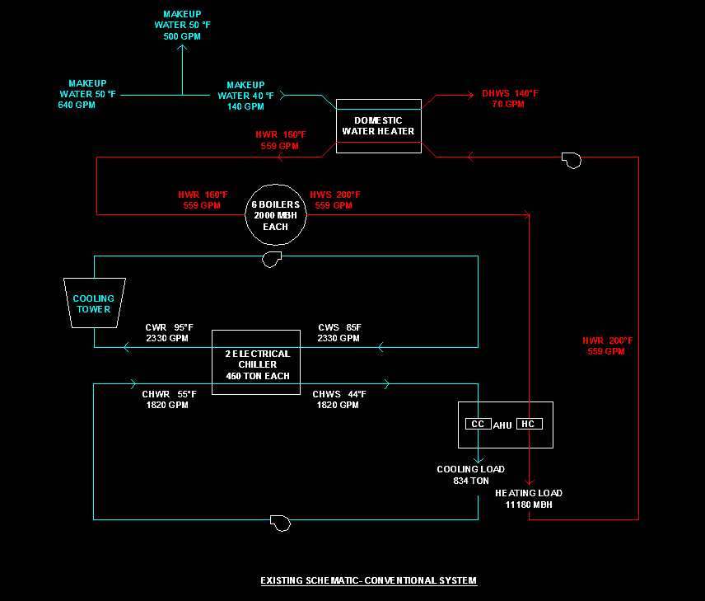
Northfield Mental Healthcare Center
Load Summary
Existing Water Flow Diagram
• Introduction
• Northfield Mental Healthcare
• Mechanical System
• Design Goals
• Alternative 1: Cogeneration
• Alternative 2: Tri-generation
• Comparison
• Breadth: Electrical Breadth
• Summary
• Acknowledgements
• Questions
Summary of Load
Cooling (TONS) | 834 TONS
Space Heating (MBH) | 11,180 MBH
Summary of Water Supply Needs
Chilled Water @11F Difference | 1,820 GPM
Hot Water @ 40F Difference | 560 GPM
Domestic Hot Water | 140 GPM

Slide 14
Northfield Mental Healthcare Center
Annual Energy Consumption Summary
Existing Water Flow Diagram
• Introduction
• Northfield Mental Healthcare
• Mechanical System
• Design Goals
• Alternative 1: Cogeneration
• Alternative 2: Tri-generation
• Comparison
• Breadth: Electrical Breadth
• Summary
• Acknowledgements
• Questions
Summary of Annual Energy Consumption
Total Electricity Consumption | 14,127,906 KWh
Total Natural Gas Consumption | 636,589 Therms
Total Energy Consumption | 32,779,801 KWh
EUI Value Calculated
Electricity EUI | 185 kBtu / SF
Natural Gas EUI | 250 kBtu / SF
EUI | 435 kBtu / SF
EUI Value of Typical Hospital (Baseline Model)
EUI | 388 kBtu / SF

Slide 15
Northfield Mental Healthcare Center
Design Goals
Existing Water Flow Diagram
• Introduction
• Northfield Mental Healthcare
• Mechanical System
• Design Goals
• Alternative 1: Cogeneration
• Alternative 2: Tri-generation
• Comparison
• Breadth: Electrical Breadth
• Summary
• Acknowledgements
• Questions
Primary Goal:
Reduce energy consumption
Secondary Goal:
Reduce emissions
EUI Value Calculated
Electricity EUI | 185 kBtu / SF
Natural Gas EUI | 250 kBtu / SF
EUI | 435 kBtu / SF
EUI Value of Typical Hospital (Baseline Model)
EUI | 388 kBtu / SF

Slide 16
Northfield Mental Healthcare Center
CHP System
Spark Spread
• Introduction
• Alternative 1: Cogeneration
• CHP System
• CHP Module Simple Payback
• Cogeneration Schematic
• Cogeneration Energy Saving
• Alternative 2: Tri-generation
• Comparison
• Breadth: Electrical Breadth
• Summary
• Acknowledgements
• Questions
Spark Spread
Difference between electricity and gas rate in $/MMBtu
Spark Spread >$12/MMBtu → CHP has the potential for favorable payback
Combined Heat and Power (CHP) system
CHP supplies energy in two forms:
•Electricity
•Heat
Spark Spread
Determine the Average Annual Electric Cost ($/MMBtu) | 29.30
Determine the Average Gas Cost ($/MMBtu) | 7.550
Spark Spread | 22

Slide 17
Northfield Mental Healthcare Center
Prime Mover Selection
Prime Mover Selection
• Introduction
• Alternative 1: Cogeneration
• CHP System
• CHP Module Simple Payback
• Cogeneration Schematic
• Cogeneration Energy Saving
• Alternative 2: Tri-generation
• Comparison
• Breadth: Electrical Breadth
• Summary
• Acknowledgements
• Questions
T/P Ratio
1. Determine Thermal Use
Total Thermal Energy Delivered/Used | 63,658,920,000 Btu
2. Determine Electrical Use
Total Electric | 48,218,544,000 Btu
3. Determine T/P Ratio
T/P Ratio - Divide Total Thermal (Btu) by Total Electric (Btu): | 1.32
 | Capacity | Installation Costs | O&M Costs
Reciprocating Engines | 5 kWe - 20 MWe | $1,000 to $1,800 per kW | $0.010 to $0.015 per kWh
Gas Turbines | 25 kWe – 500 kWe | $800 to $1,500 per kW | $0.005 to $0.008 per kWh
Microturbines | 500 kWe – 100 kWe | $1,000 to $2,000 per kW | $0.010 to $0.015 per kWh
Recommended Prime Mover Technology Based on T/P Ratio
If T/P =
0.5 to 1.5 | Consider engines
1 to10 | Consider gas turbines
3 to 20 | Consider steam turbines

Slide 18
Northfield Mental Healthcare Center
CHP Module Sizing
CHP Module Selection
• Introduction
• Alternative 1: Cogeneration
• CHP System
• CHP Module Simple Payback
• Cogeneration Schematic
• Cogeneration Energy Saving
• Alternative 2: Tri-generation
• Comparison
• Breadth: Electrical Breadth
• Summary
• Acknowledgements
• Questions
CHP COGENERATION MODULE - 2G 1540 NG
Reciprocating engine MWM® TCG2020
Configuration | Natural Gas
Electrical Output | 1540 KW
Thermal Output | 1778 KW
Electrical Efficiency | 42.00%
Thermal Efficiency | 44.06%
Total efficiency | 80.06%
Thermal Heat | 6,066,787 Btu/h (Usable)
Water Flow rate High Temp | 17,100 Gph
Water Temp | 194F
Fuel Consumption | 12508 MBtu/h
Energy Consumption | 8,122 Btu / kW
Primary Design
Building Size (SF) | Heating Baseline (MBH) | Heating Load (MBH)
260,000 | 5,640 | 11,180
Heating Baseline = Total Heating Load X 50%
$$5,640 MBH × \frac{1,000 Btu/h}{1 MBH} × \frac{1 kW}{3,413 Btu/h} =1,653 kW$$

Slide 19
Northfield Mental Healthcare Center
CHP Module Sizing
CHP Module Selection
• Introduction
• Alternative 1: Cogeneration
• CHP System
• CHP Module Simple Payback
• Cogeneration Schematic
• Cogeneration Energy Saving
• Alternative 2: Tri-generation
• Comparison
• Breadth: Electrical Breadth
• Summary
• Acknowledgements
• Questions
CHP COGENERATION MODULE - 2G 1540 NG
Reciprocating engine MWM® TCG2020
Configuration | Natural Gas
Electrical Output | 1540 KW
Thermal Output | 1778 KW
Electrical Efficiency | 42.00%
Thermal Efficiency | 44.06%
Total efficiency | 80.06%
Thermal Heat | 6,066,787 Btu/h (Usable)
Water Flow rate High Temp | 17,100 Gph
Water Temp | 194F
Fuel Consumption | 12508 MBtu/h
Energy Consumption | 8,122 Btu / kW
Primary Design
Building Size (SF) | Heating Baseline (MBH) | Heating Load (MBH)
260,000 | 5,640 | 11,180
Heating Baseline = Total Heating Load X 50%
$$5,640 MBH × \frac{1,000 Btu/h}{1 MBH} × \frac{1 kW}{3,413 Btu/h} =1,653 kW$$

Slide 20
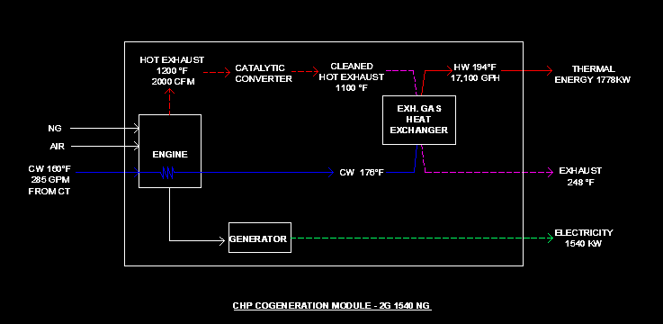
Northfield Mental Healthcare Center
CHP Module Internal Structure
CHP Module Selection
• Introduction
• Alternative 1: Cogeneration
• CHP System
• CHP Module Simple Payback
• Cogeneration Schematic
• Cogeneration Energy Saving
• Alternative 2: Tri-generation
• Comparison
• Breadth: Electrical Breadth
• Summary
• Acknowledgements
• Questions
CHP COGENERATION MODULE - 2G 1540 NG
Reciprocating engine MWM® TCG2020
Configuration | Natural Gas
Electrical Output | 1540 KW
Thermal Output | 1778 KW
Electrical Efficiency | 42.00%
Thermal Efficiency | 44.06%
Total efficiency | 80.06%
Thermal Heat | 6,066,787 Btu/h (Usable)
Water Flow rate High Temp | 17,100 Gph
Water Temp | 194F
Fuel Consumption | 12508 MBtu/h
Energy Consumption | 8,122 Btu / kW

Slide 21
Northfield Mental Healthcare Center
CHP Module Simple Payback Period
• Introduction
• Alternative 1: Cogeneration
• CHP System
• CHP Module Simple Payback
• Cogeneration Schematic
• Cogeneration Energy Saving
• Alternative 2: Tri-generation
• Comparison
• Breadth: Electrical Breadth
• Summary
• Acknowledgements
• Questions
Revenue
Electric Revenue | $1,349,040
Thermal Revenue | $401,346
Total Revenue | $1,750,386
Heat Recovery
Heat Recovery | 6,068,314 Btu/hr
Heating Load | 11,180,000 Btu/hr
Heat Recovery Basis Efficiency | 60%
Expenses
Fuel Expenses | $827,254
O&M Costs | $168,630
Standby Charge | $55,440
Total Expenses | $1,051,324
Energy Generation & Fuel Consumption
Annual Electric Generation | 13,490,400 kWh
Annual Thermal Generation | 53,158 MMBtu
Annual Fuel Consumption | 109,570 MMBtu
Saving
Total Saving | $699,062

Slide 22
Northfield Mental Healthcare Center
CHP Module Simple Payback Period
• Introduction
• Alternative 1: Cogeneration
• CHP System
• CHP Module Simple Payback
• Cogeneration Schematic
• Cogeneration Energy Saving
• Alternative 2: Tri-generation
• Comparison
• Breadth: Electrical Breadth
• Summary
• Acknowledgements
• Questions
Revenue
Electric Revenue | $1,349,040
Thermal Revenue | $401,346
Total Revenue | $1,750,386
Heat Recovery
Heat Recovery | 6,068,314 Btu/hr
Heating Load | 11,180,000 Btu/hr
Heat Recovery Basis Efficiency | 60%
Expenses
Fuel Expenses | $827,254
O&M Costs | $168,630
Standby Charge | $55,440
Total Expenses | $1,051,324
Energy Generation & Fuel Consumption
Annual Electric Generation | 13,490,400 kWh
Annual Thermal Generation | 53,158 MMBtu
Annual Fuel Consumption | 109,570 MMBtu
Saving
Total Saving | $699,062

Slide 23
Northfield Mental Healthcare Center
CHP Module Simple Payback Period
• Introduction
• Alternative 1: Cogeneration
• CHP System
• CHP Module Simple Payback
• Cogeneration Schematic
• Cogeneration Energy Saving
• Alternative 2: Tri-generation
• Comparison
• Breadth: Electrical Breadth
• Summary
• Acknowledgements
• Questions
Revenue
Electric Revenue | $1,349,040
Thermal Revenue | $401,346
Total Revenue | $1,750,386
Payback
First Cost | $2,310,000
Total Saving | $699,062
Simple Payback | 3.30 Yrs
Expenses
Fuel Expenses | $827,254
O&M Costs | $168,630
Standby Charge | $55,440
Total Expenses | $1,051,324
Saving
Total Saving | $699,062

Slide 24
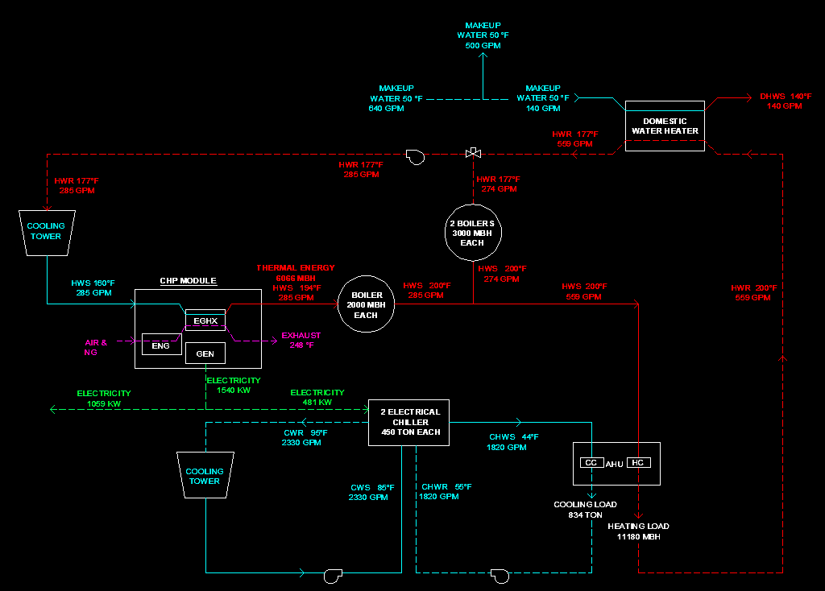
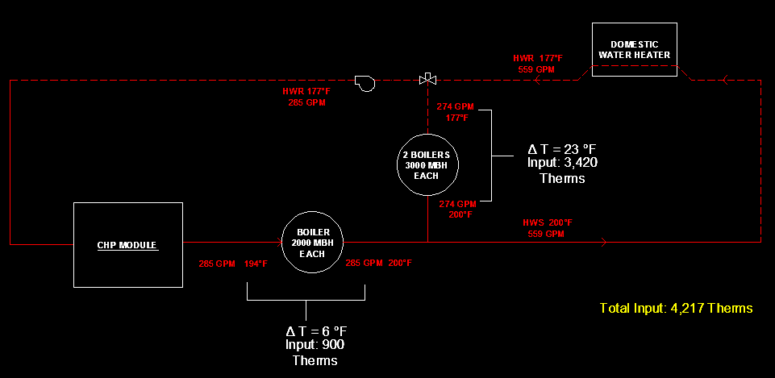
Northfield Mental Healthcare Center
Cogeneration Schematic
Cogeneration Schematic
• Introduction
• Alternative 1: Cogeneration
• CHP System
• CHP Module Simple Payback
• Cogeneration Schematic
• Cogeneration Energy Saving
• Alternative 2: Tri-generation
• Comparison
• Breadth: Electrical Breadth
• Summary
• Acknowledgements
• Questions

Slide 25
Northfield Mental Healthcare Center
Annual Energy Consumption
Annual Net Saving
• Introduction
• Alternative 1: Cogeneration
• CHP System
• CHP Module Simple Payback
• Cogeneration Schematic
• Cogeneration Energy Saving
• Alternative 2: Tri-generation
• Comparison
• Breadth: Electrical Breadth
• Summary
• Acknowledgements
• Questions
 |  | Annual Energy Generated |  | Annual Energy Consumption (Space Heating &Space Cooling)
 |  | Thermal (MMBtu) | Electricitiy (KWh) | Thermal (MMBtu) | Electricitiy (KWh)
Existing | Heating | - | - | 103,091 | -
 | Cooling |  |  | - | 4,204,800
Alternative 1 | Heating | 53,138 | 13,490,400 | 78,840 | -
 | Cooling |  |  | - | 4,204,800
 | Annual Net Saving
 | Thermal (MMBtu) | Electricitiy (KWh) | Thermal ($) | Electricitiy ($) | Total ($)
Existing vs. Alternative1 | 24,251 | 13,490,400 | 183,098 | 1,349,040 | 1,532,138

Slide 26
Northfield Mental Healthcare Center
CHPC System
Absorption Chiller Selection
• Introduction
• Alternative 1: Cogeneration
• Alternative 2: Tri-generation
• CHPC System
• Tri-generation Schematic
• Tri-generation Energy Saving
• Comparison
• Breadth: Electrical Breadth
• Summary
• Acknowledgements
• Questions
Chiller Type | Heat Production (Brtu/kWh) |  | Absorber COP |  | Cooling Available (Tons/kW)
 | Min. | Max. | Min. | Max. | Min. | Max.
Single Effect | 3,800 | 6,000 | 0.70 | 0.78 | 0.22 | 0.35
Double Effect | 1,500 | 2,000 | 1.10 | 1.30 | 0.15 | 0.20
Combined Heat, Power and Cooling (CHPC) system
CHPC supplies energy in three forms:
•Electricity
•Heat
•Chilled water
Absorption Chiller Selection
Carrier 16JLR 47
(Single Effect Lithium Bromide - Water Absorption Chiller)
Cooling Capacity | 450 Tons
Chilled Water Temp | 54 / 44 F
Cooling Water Temp | 85 / 95 F
Hot Water Temp | 203 / 185 F
COP | 0.7

Slide 27
Northfield Mental Healthcare Center
CHPC System
Absorption Chiller Selection
• Introduction
• Alternative 1: Cogeneration
• Alternative 2: Tri-generation
• CHPC System
• Tri-generation Schematic
• Tri-generation Energy Saving
• Comparison
• Breadth: Electrical Breadth
• Summary
• Acknowledgements
• Questions
Chiller Type | Heat Production (Brtu/kWh) |  | Absorber COP |  | Cooling Available (Tons/kW)
 | Min. | Max. | Min. | Max. | Min. | Max.
Single Effect | 3,800 | 6,000 | 0.70 | 0.78 | 0.22 | 0.35
Double Effect | 1,500 | 2,000 | 1.10 | 1.30 | 0.15 | 0.20
Combined Heat, Power and Cooling (CHPC) system
CHPC supplies energy in three forms:
•Electricity
•Heat
•Chilled water
Absorption Chiller Selection
Carrier 16JLR 47
(Single Effect Lithium Bromide - Water Absorption Chiller)
Cooling Capacity | 450 Tons
Chilled Water Temp | 54 / 44 F
Cooling Water Temp | 85 / 95 F
Hot Water Temp | 203 / 185 F
COP | 0.7

Slide 28
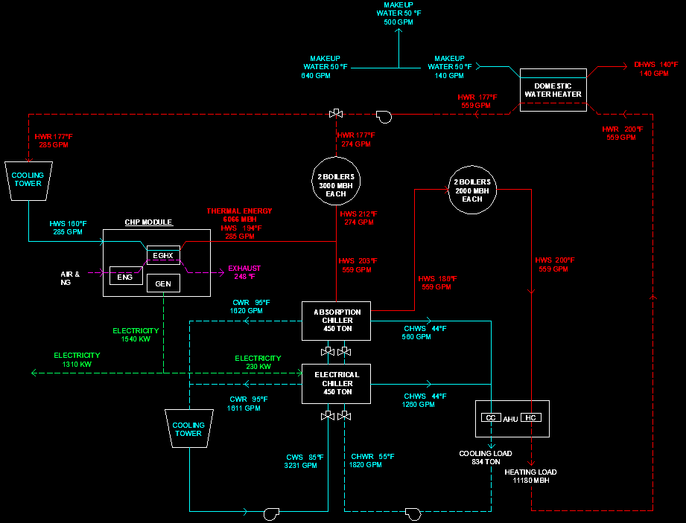
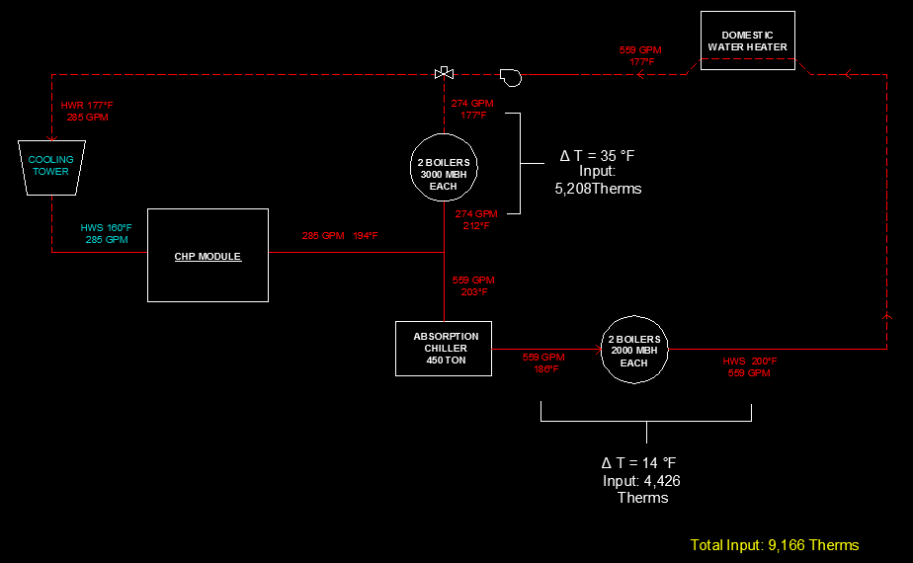
Northfield Mental Healthcare Center
Tri-generation Schematic
Heating Side Schematic
• Introduction
• Alternative 1: Cogeneration
• Alternative 2: Tri-generation
• CHPC System
• Tri-generation Schematic
• Tri-generation Energy Saving
• Comparison
• Breadth: Electrical Breadth
• Summary
• Acknowledgements
• Questions

Slide 29
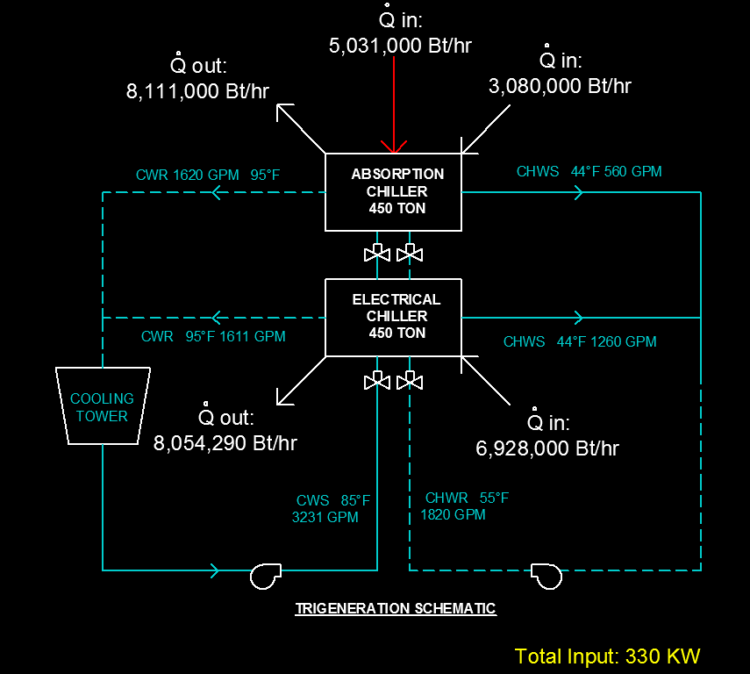
Northfield Mental Healthcare Center
Tri-generation Schematic
Cooling Side Schematic
• Introduction
• Alternative 1: Cogeneration
• Alternative 2: Tri-generation
• CHPC System
• Tri-generation Schematic
• Tri-generation Energy Saving
• Comparison
• Breadth: Electrical Breadth
• Summary
• Acknowledgements
• Questions

Slide 30
Northfield Mental Healthcare Center
Annual Energy Consumption
Annual Net Saving
• Introduction
• Alternative 1: Cogeneration
• Alternative 2: Tri-generation
• CHPC System
• Tri-generation Schematic
• Tri-generation Energy Saving
• Comparison
• Breadth: Electrical Breadth
• Summary
• Acknowledgements
• Questions
 |  | Annual Energy Generated |  | Annual Energy Consumption (Space Heating &Space Cooling)
 |  | Thermal (MMBtu) | Electricitiy (KWh) | Thermal (MMBtu) | Electricitiy (KWh)
Existing | Heating | - | - | 103,091.37 | -
 | Cooling |  |  | - | 4,204,800
Alternative 2 | Heating | 53,138 | 13,490,400 | 80,296.93 | -
 | Cooling |  |  |  | 2,890,800
 | Annual Net Saving
 | Thermal (MMBtu) | Electricitiy (KWh) | Thermal ($) | Electricitiy ($) | Total ($)
Existing vs. Alternative2 | 22,794 | 14,804,400 | 172,098 | 1,480,440 | 1,652,538

Slide 31
Northfield Mental Healthcare Center
Comparison- Annual Net Saving
Comparison- First Cost
• Introduction
• Alternative 1: Cogeneration
• Alternative 2: Tri-generation
• Comparison
• Annual Energy Cost
• Emission
• Breadth: Electrical Breadth
• Summary
• Acknowledgements
• Questions
First Cost | Existing | Alternative 1 | Alternative 2
Boilers | $2,280,000 | $1,387,000 | $1,900,000
Electric Chiller | $304,000 | $304,000 | $152,000
Absorption Chiller | $0 | $0 | $180,000
Pumps | $400,000 | $400,000 | $400,000
Total | $2,984,000 | $2,091,000 | $2,632,000
Saving On First Cost | $0 | $893,000 | $352,000
 | Annual Net Saving
 | Thermal (MMBtu) | Electricitiy (KWh) | Thermal ($) | Electricitiy ($) | Total ($)
Existing vs. Alternative1 | 24,251 | 13,490,400 | 183,098 | 1,349,040 | 1,532,138
Existing vs. Alternative2 | 22,794 | 14,804,400 | 172,098 | 1,480,440 | 1,652,538
Alternative2 vs. Alternative 1 | (1,457) | 1,314,000 | (11,000) | 131,400 | 120,400
Alternative 1: More Saving on First Cost
Alternative 2: More Saving on Annual Energy Consumption

Slide 32
Northfield Mental Healthcare Center
Emission- Alternative 1
Emission- Alternative 2
• Introduction
• Alternative 1: Cogeneration
• Alternative 2: Tri-generation
• Comparison
• Annual Energy Cost
• Emission
• Breadth: Electrical Breadth
• Summary
• Acknowledgements
• Questions
Annual Emissions Analysis - Alternative 1
 | Emissions/Fuel Reduction | Percent Reduction
NOx (tons/year) | (4.452) | (0.469)
SO2 (tons/year) | 22.205 | 0.998
CO2 (tons/year) | 4,369 | 0.362
CH4 (tons/year) | 0.090 | 0.384
N2O (tons/year) | 0.122 | 0.894
Total GHGs (CO2e tons/year) | 4,408 | 0.364
Carbon (metric tons/year) | 1,080 | 0.362
Fuel Consumption (MMBtu/year) | 22,298 | 0.145
Number of Cars Removed | 765
Annual Emissions Analysis - Alternative 2
 | Emissions/Fuel Reduction | Percent Reduction
NOx (tons/year) | 1.317 | 0.086
SO2 (tons/year) | 40.830 | 0.999
CO2 (tons/year) | 9,350 | 0.548
CH4 (tons/year) | 0.191 | 0.568
N2O (tons/year) | 0.227 | 0.940
Total GHGs (CO2e tons/year) | 9,425 | 0.550
Carbon (metric tons/year) | 2,312 | 0.548
Fuel Consumption (MMBtu/year) | 63,561 | 0.326
Number of Cars Removed | 1,637

Slide 33
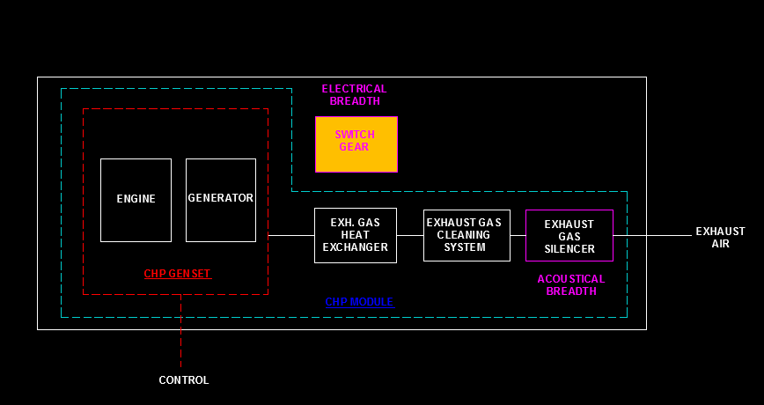
Northfield Mental Healthcare Center
Electrical Breadth
Code Analysis
• Introduction
• Alternative 1: Cogeneration
• Alternative 2: Tri-generation
• Comparison
• Breadth: Electrical Breadth
• Code Analysis
• Load Distribution Analysis
• Sizing Conductors
• Summary
• Acknowledgements
• Questions
NEC 517.31 and NFPA 99 3-4.3.1
Emergency generator Startup time (Healthcare facility) < 10 s
CHP system cannot serve for the life safety load & critical load.
Replacing existing emergency generator with CHP generator

Slide 34
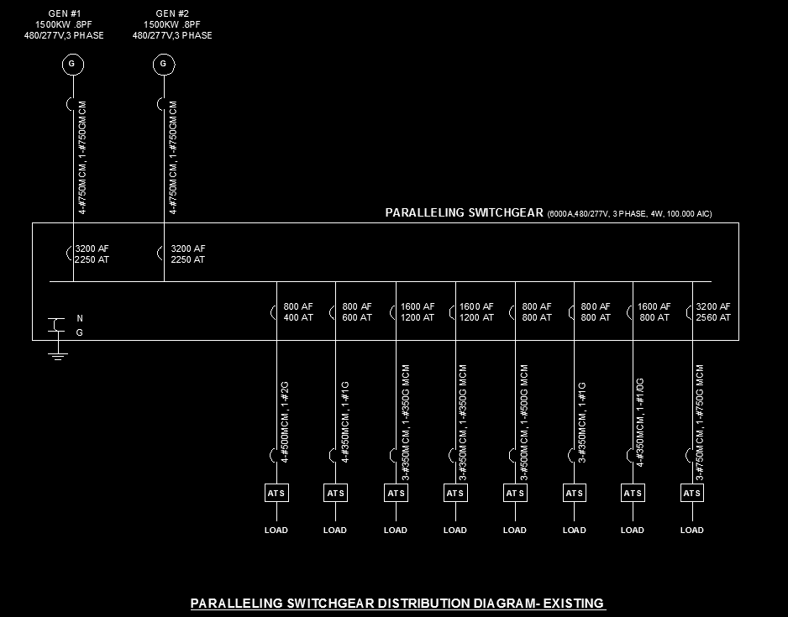
Northfield Mental Healthcare Center
Emergency Generator - Existing
Load Distribution - Existing
• Introduction
• Alternative 1: Cogeneration
• Alternative 2: Tri-generation
• Comparison
• Breadth: Electrical Breadth
• Code Analysis
• Load Distribution Analysis
• Sizing Conductors
• Summary
• Acknowledgements
• Questions

Slide 35
Northfield Mental Healthcare Center
Load Distribution Analysis
Load Distribution - Existing
• Introduction
• Alternative 1: Cogeneration
• Alternative 2: Tri-generation
• Comparison
• Breadth: Electrical Breadth
• Code Analysis
• Load Distribution Analysis
• Sizing Conductors
• Summary
• Acknowledgements
• Questions
 | Percentage (%)
Critical & Life Safety | 50.2
Equipment System | 49.8
Total | 100
Each of existing emergency generators serves 50% of total emergency load.
Gen #1 is big enough to serve as the life safety load and critical load.
Gen #2 will be replaced by the CHP generator.

Slide 36
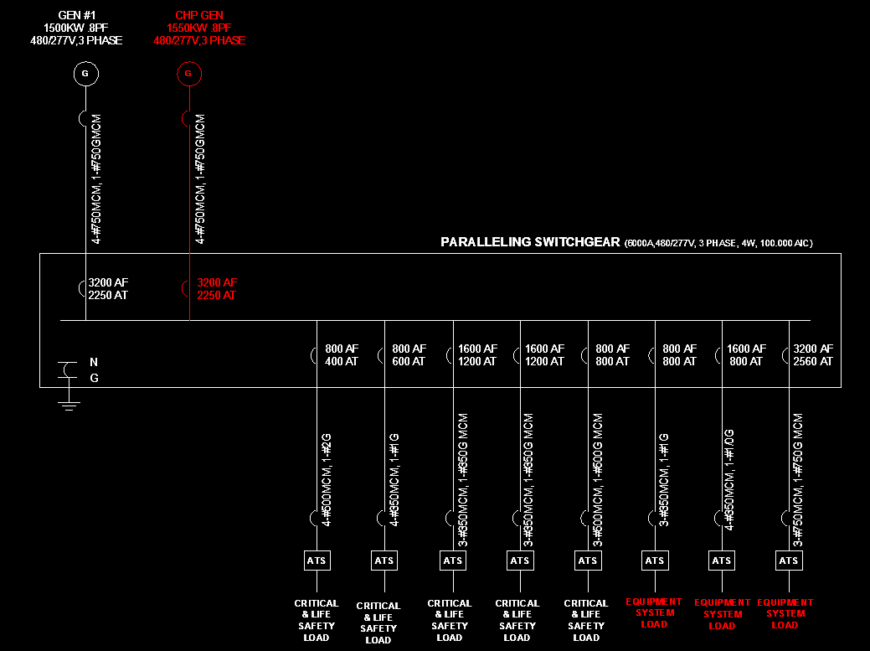
Northfield Mental Healthcare Center
Load Distribution Analysis
Load Distribution – New Design
• Introduction
• Alternative 1: Cogeneration
• Alternative 2: Tri-generation
• Comparison
• Breadth: Electrical Breadth
• Code Analysis
• Load Distribution Analysis
• Sizing Conductors
• Summary
• Acknowledgements
• Questions
 | Percentage (%)
Critical & Life Safety | 50.2
Equipment System | 49.8
Total | 100
Each of existing emergency generators serves 50% of total emergency load.
Gen #1 is big enough to serve as the life safety load and critical load.
Gen #2 will be replaced by the CHP generator.

Slide 37
Northfield Mental Healthcare Center
Conductors Sizing
Load Distribution – New Design
• Introduction
• Alternative 1: Cogeneration
• Alternative 2: Tri-generation
• Comparison
• Breadth: Electrical Breadth
• Code Analysis
• Load Distribution Analysis
• Sizing Conductors
• Summary
• Acknowledgements
• Questions
Sizing Conductors
Electrical Output | 1,540 | KW
Power Factor | 0.90
Voltage | 480 | V
Amps | 1,667 | A
Over Current Protection (115%) | 1,917 | A
Up sized: 4 set of # 750 MCM, 1 set of #750 G MCM
NEC 445.13. Over Current Protection For Generator : 115%

Slide 38
Northfield Mental Healthcare Center
Net Saving
Emission
• Introduction
• Alternative 1: Cogeneration
• Alternative 2: Tri-generation
• Comparison
• Breadth: Electrical Breadth
• Summary
• Acknowledgements
• Questions
 | Alternative 1 | Alternative 2
 | Percent Reduction
Carbon (metric tons/year) | 36% | 55%
Fuel Consumption (MMBtu/year) | 14% | 33%
 | Alternative 1 | Alternative 2
Net Saving ($) | 1,532,138 | 1,652,538
Primary Goal:
Reduce energy consumption
Secondary Goal:
Cut back on emissions

Slide 39
Northfield Mental Healthcare Center
Northfield Mental Healthcare Center
• Introduction
• Alternative 1: Cogeneration
• Alternative 2: Tri-generation
• Comparison
• Breadth: Electrical Breadth
• Summary
• Acknowledgements
• Questions
Questions?
Special Thanks to:
James D. Freihaut, PhD – Professor of AE Dept.
Moses D. F. Ling, PE, RA – Associate Professor of AE Dept.
Stephen Treado, Ph.D., P.E. –Associate Professor of AE Dept.
William P. Bahnfleth, PhD, PE - Professor, AE Dept.
Doug Smelker– Scheeser Buckley Mayfield LLC
Jason Wilson – Scheeser Buckley Mayfield LLC
Josh Roehm – Scheeser Buckley Mayfield LLC

